Slide 1

Sustainable Management of Sugarcane Trash & Filter Cake to improve soil fertility and Sugarcane productivity
Presented By:
Muhammad Tariq Saleem,
Tariq.saleem@habibsugar.com

Slide 2
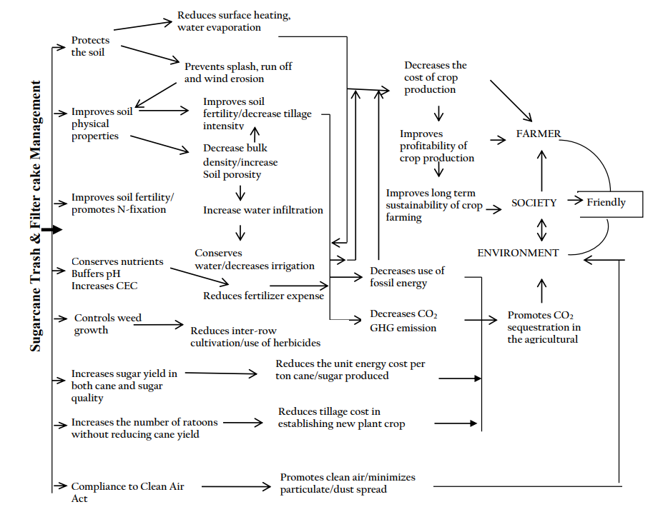
Importance of Filter cake & Trash blanket

Slide 3
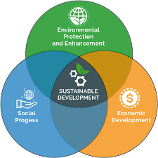
Advantages
Improve Soil Health
Reduce cost of Production
Suppress weeds
Improve water use efficiency
Enhance inputs use efficiency leading to high profit
Increase Sugarcane quantity as well as Sugar quality
Protects our ecosystem
Protect human health
Preserves natural resources for future generations

Slide 4
Nutrients Composition
Sugarcane Trash
Sugarcane Filter Cake
Nutrients | % Age
Organic Matter | 68
Nitrogen | 0.35
Phosphorus | 0.15
Potash | 0.75-1.0
Nutrients | % Age
Organic Matter | 70-75
pH | 6-7
Nitrogen | 2.0
Phosphorus | 1.20
Potash | 0.70-1.10

Slide 5
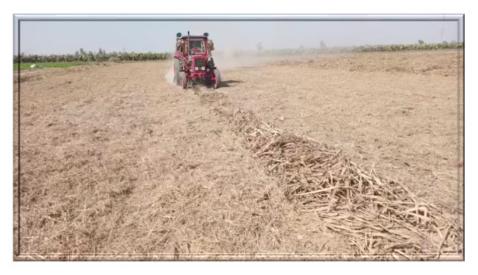
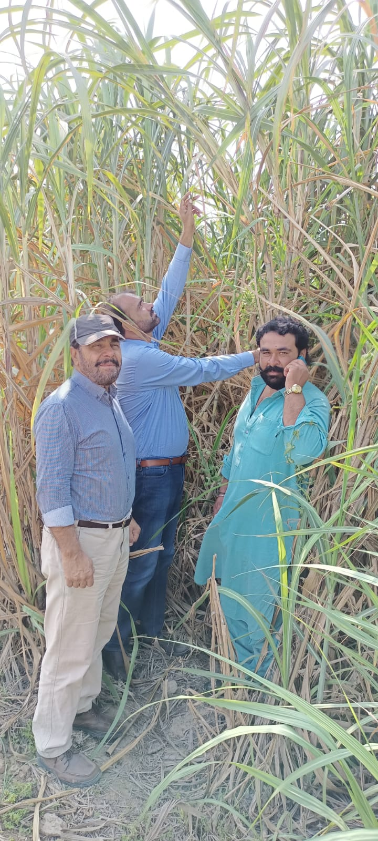
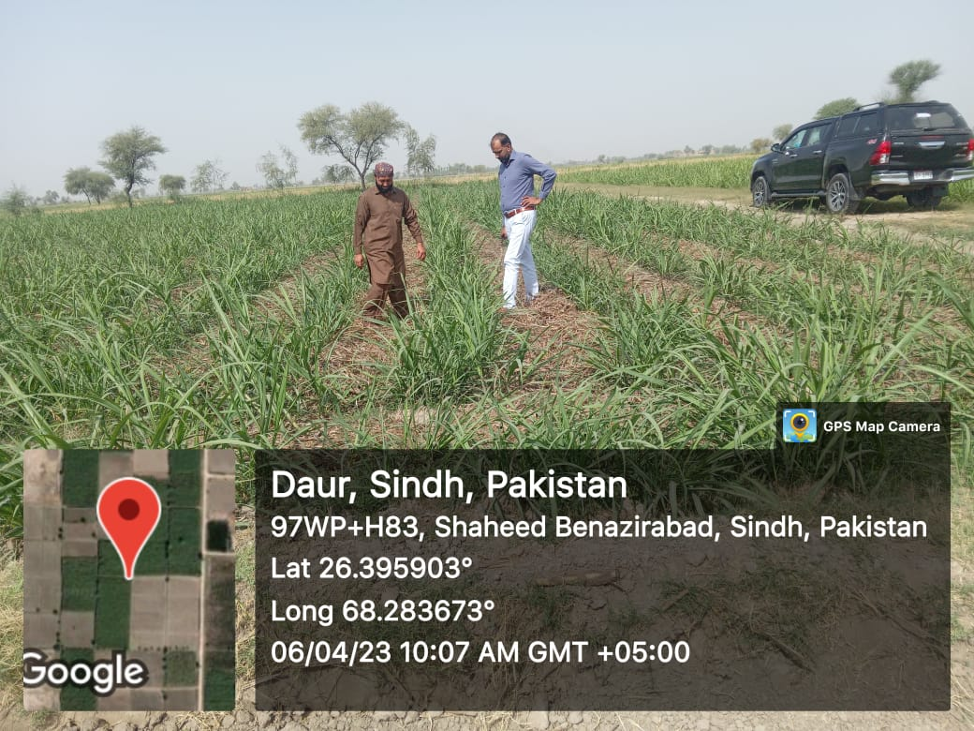
Research Story in Habib Sugar Mills, Nawabshah

Slide 6
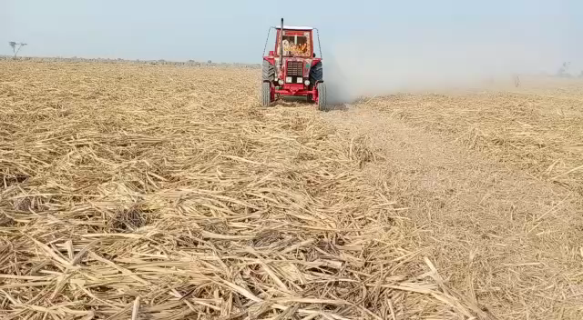
Trash Mulching operation

Slide 7
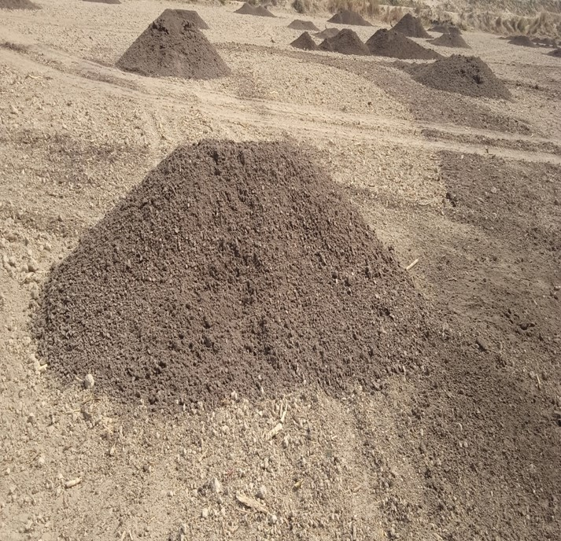
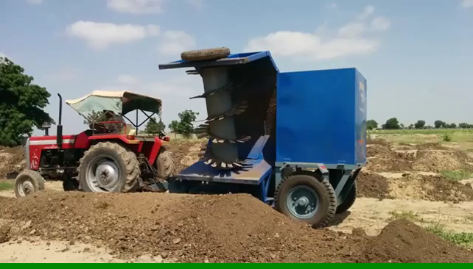
Working in Habib Sugar Mills, Nawabshah

Slide 8
Trial No.1 Impact of Trash mulching Vs Trash Burning on Sugarcane Yield (Trial area: 6 acre)
 | Plot No.1 (CSSG-676) | Plot No.2 (CPF-253) | Plot No.3 (CPF-246) | Average
Trash Mulching (Monds) | 730 | 789 | 758 | 759
Trash Burning (Monds) | 617 | 690 | 624 | 643
Increase over Trash Burning |  |  |  | 18.04 %

Slide 9
Trial No.1 Impact of Trash mulching Vs Trash Burning on Sugar Recovery (Trial area: 6 acre)
Description | Plot No.1 (CSSG-676) |  |  |  | Plot No.2 (CPF-253) |  |  |  | Plot No.3 (CPF-246) |  |  |  | Overall Average
 | October | November | December | Average | October | November | December | Average | October | November | December | Average
Trash Mulching | 9.96 | 10.98 | 11.92 | 10.95 | 9.10 | 9.75 | 11.01 | 9.95 | 9.77 | 10.60 | 11.79 | 10.72 | 10.54
Trash Burning | 9.61 | 10.53 | 11.64 | 10.59 | 8.5 | 9.41 | 10.7 | 9.54 | 9.37 | 10.3 | 11.52 | 10.40 | 10.18
Difference | 0.35 | 0.45 | 0.28 | 0.36 | 0.60 | 0.34 | 0.31 | 0.42 | 0.40 | 0.30 | 0.27 | 0.32 | 0.37

Slide 10
Trial No.2 Economic Assessment Trash management Vs Trash Burning (Trial area: 2 acres)
Plot No.1 Trash Burning
Plot No.2 Trash Management
Description | UOM | Amount (Rs.)
DAP (Bags) | 2 | 19,600
Urea (Bags) | 4 | 7,200
SOP | 1 | 11,300
Intercultural operation | 2 | 2,000
Herbicide |  | 2,500
Total Cost (Rs.) |  | 42,600
No. of Irrigations | 14
Description | UOM | Amount (Rs.) | Cost Saving over Control (%)
DAP (Bags) | 1.5 | 14,700 | 25.00
Urea (Bags) | 3 | 5,400 | 25.00
SOP | 1 | 11,300 | -
Trash Shredding | 1 | 1,000 | 50.00
Herbicide | 0 | - | 100.00
Total Cost (Rs.) |  | 32,400 | 23.94
No. of Irrigations | 10 |  | 28.57

Slide 11
Trial No.2 Impact on Sugarcane Yield
 | No. of acre | Variety | Yield (Monds)
Trash Mulching (Control Dose) | 1 | CSSG-676 | 705
Trash Burning (Full Dose) | 1 | CSSG-676 | 644
Increase over Control (% age) |  |  | 9.47 %

Slide 12
Trial No.2 Impact on Sugar Recovery Percentage
Description | No. of Acre | Plot No.1 (CSSG-676)
 |  | October | November | December | Average
Trash Mulching (Control Dose) | 1 | 9.83 | 10.64 | 11.80 | 10.76
Trash Burning (Full Dose) | 1 | 9.5 | 10.31 | 11.42 | 10.41
Difference |  | 0.33 | 0.33 | 0.38 | 0.35

Slide 13
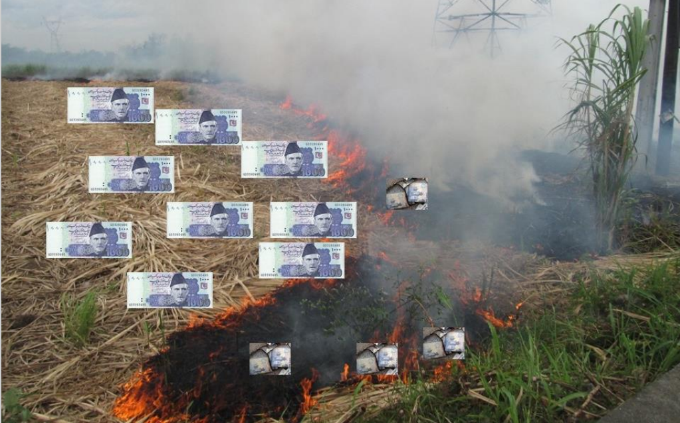
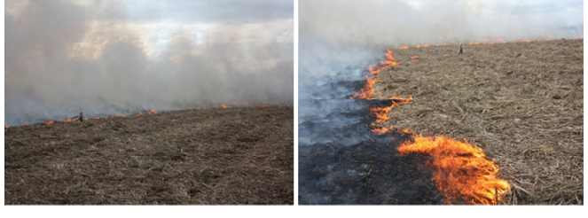
Impact of Trash Burning
Economic Loss
Threat on Environment & Human Health

Slide 14
Trial No.3 Impact of Filter Cake on Sugarcane Yield (Spring Plantation)
 | No. of acre | Variety | Yield (Monds)
Filter Cake (20 Tons) | 1 | CPF-253 | 857
Control Plot | 1 | CPF-253 | 709
Increase over Control (% age) |  |  | 20.87

Slide 15
Conclusions & Recommendation;
Keeping in view the experimental facts Trash & Filter cake have significantly impact on sugarcane yield per acre as well Sucrose contents.
Trash mulching and filter cake enrich soil health also protect the human health and ensure healthy ecosystem
Water saving (Increase irrigation interval)
Recommendation
Cool message for all Sugar mills to motivate area growers to adopt trash mulching.
Request to all Sugar Mills, Like Habib Suagr Mills to provide filter cake free of cost to area growers.

Slide 16


